Slide 1
Unit - 2
SONET, Wireless and Mobile Networks

Slide 2
    14-3 SONET
SONET is a wide area network (WAN), technology that is used as a transport network to carry loads from other WANs.
We first discuss SONET as a protocol, and we then show how SONET networks can be constructed from the standards defined in the protocol.
SONET was developed by ANSI;
SDH was developed by ITU-T.
Both uses synchronous TDM Multiplexing
14.<number>
Notes:
14.#

Slide 3
14.3.1 Architecture
Both are fundamentally similar and compatible.
Let us first introduce the architecture of a SONET system: signals, devices, and connections.
SONET Defines a hierarchy of electrical signaling levels called Synchronous Transport Signal.
Corresponding optical signals are called Optical Carriers.
In SDH it is called Synchronous Transport Module.
14.<number>
Notes:
14.#

Slide 4

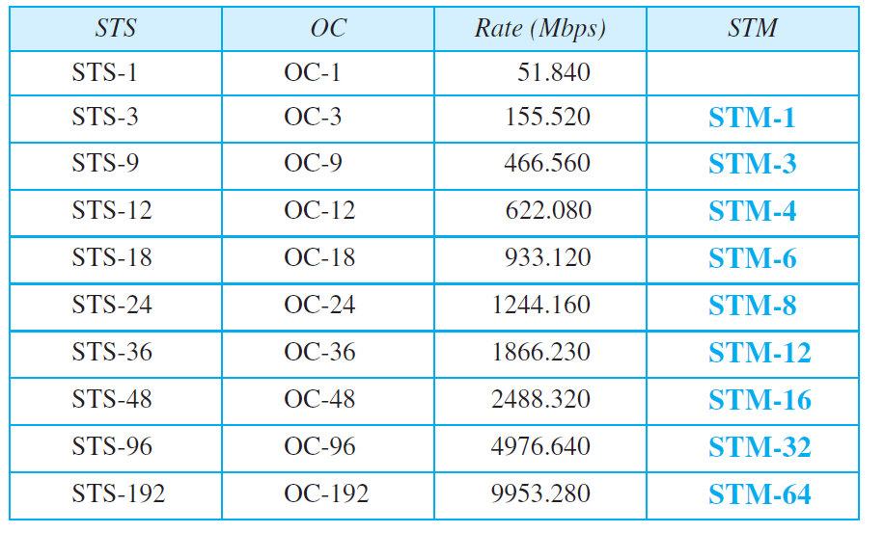
Table 14.1: SONET rates
14.<number>
13.<number>

Slide 5
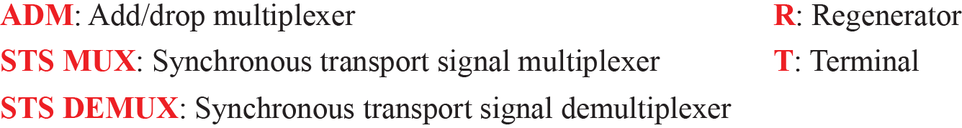
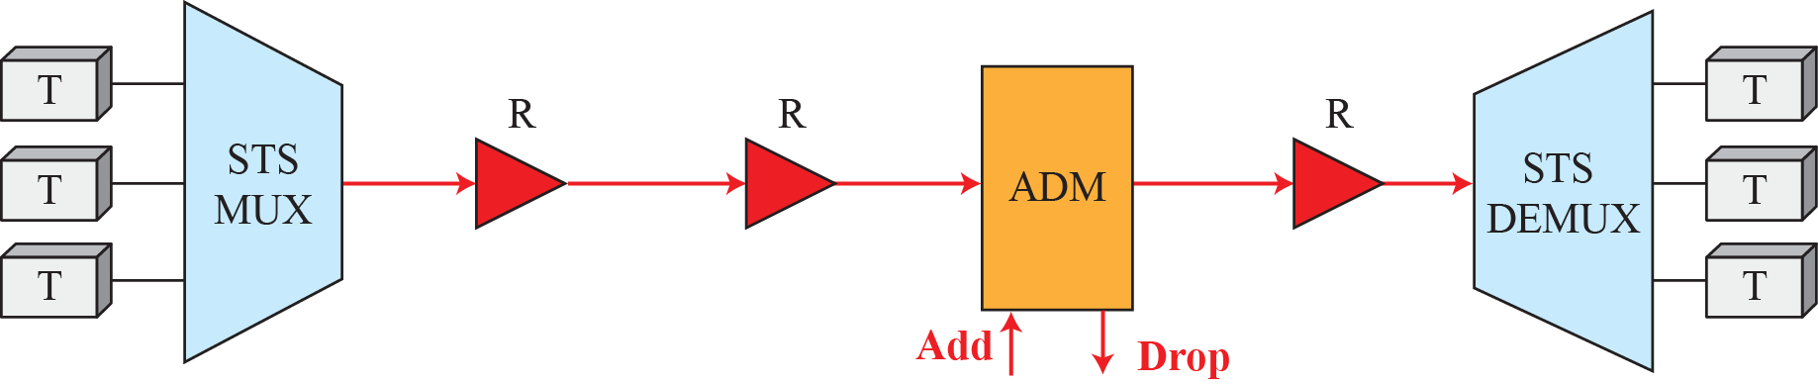
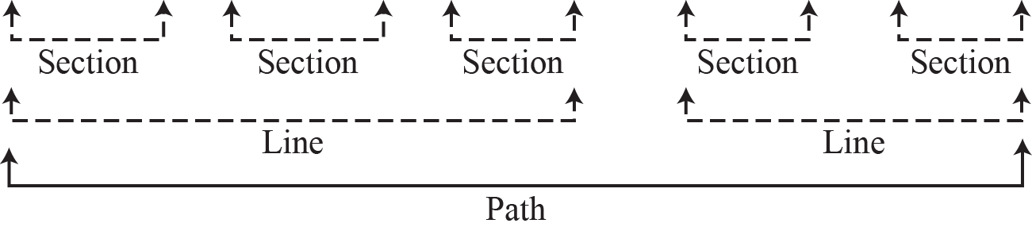
Figure 14.14: A simple network using SONET equipment
14.<number>
Notes:
14.#

Slide 6
SONET Devices
STS Multiplexer / Demultiplexer
Regenerator – Extend the length of the link
Add / Drop Multiplexer – can add STSs coming from multiple sources into a given path or can remove a given signal from a path and redirect it
Terminals
13.<number>

Slide 7
Connections
Sections – optical link connecting two neighbouring devices
Lines – between two multiplexers
Paths – end –to-end portion of the network
13.<number>

Slide 8
14.3.2 SONET Layers
The SONET standard includes four functional layers: the photonic, the section, the line, and the path layer. They correspond to both the physical and the data-link layers (see Figure 14.15). The headers added to the frame at the various layers are discussed later in this chapter.
14.<number>
Notes:
14.#

Slide 9
SONET Layers
Path layer – responsible for movement of signal from optical source to optical destination
Line layer – movement of signal across the line
Section layer - movement of signal across the section. It handles Framing, Scrambling and Error Control
POH. LOH and SOH is added to the frame
Photonic layer – physical specifications of optical fiber, sensitivity of the receiver, multiplexing functions etc.
SONET uses NRZ encoding with presence of light representing 1 and absence of light representing 0
13.<number>

Slide 10
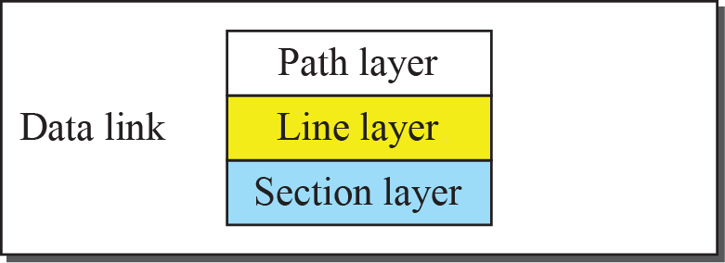
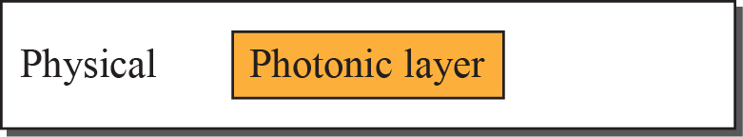
Figure 14.15: SONET layers compared with OSI or the Internet layers
14.<number>
Notes:
14.#

Slide 11
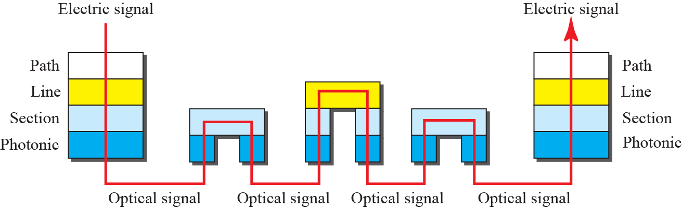
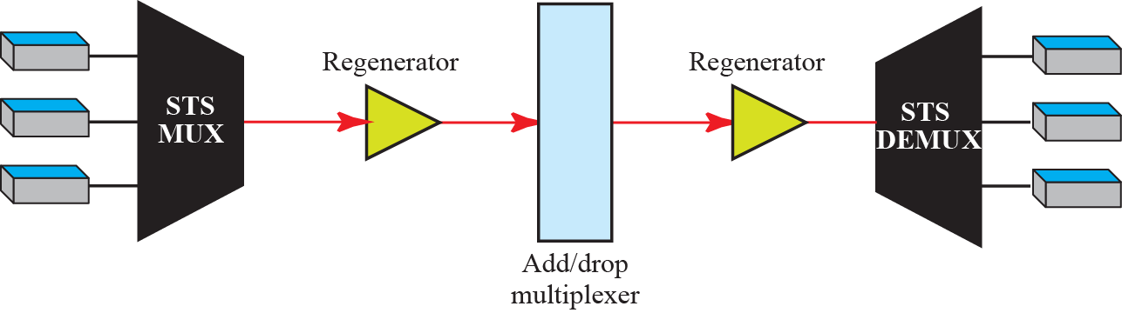
Figure 14.16: Device-Layer relationship in SONET
14.<number>
Notes:
14.#

Slide 12
14.3.3 SONET Frames
Each synchronous transfer signal STS-n is composed of 8000 frames. Each frame is a two-dimensional matrix of bytes with 9 rows by 90 × n columns. For example, an STS-1 frame is 9 rows by 90 columns (810 bytes), and an STS-3 is 9 rows by 270 columns (2430 bytes). Figure 14.17 shows the general format of an STS-1 and an STS-n.
14.<number>
Notes:
14.#

Slide 13
SONET Frames
Each STS – n frame is composed of 9 rows and 90 X n columns
It is transmitted at a fixed rate of 8000 frames per second.
If we sample a voice signal and use 8 bits for each sample, then each byte in a SONET frame can carry a digitized voice channel. (STS-1 frame can carry 774 voice channels – (810 – 36 = 774))
13.<number>

Slide 14
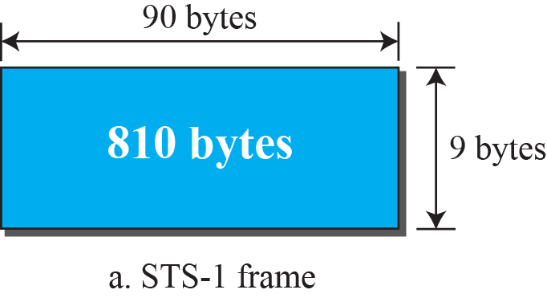
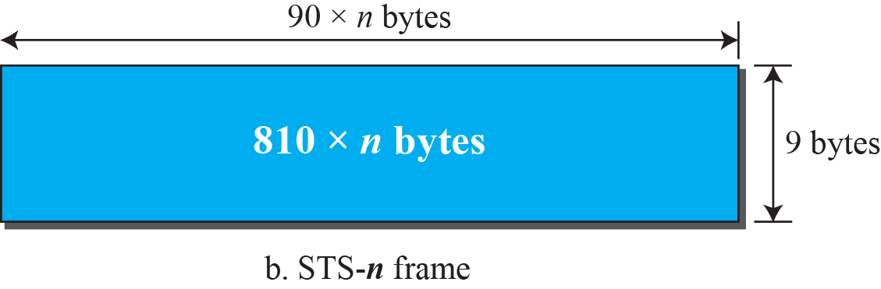
Figure 14.17: An STS-1 and an STS-n frame
14.<number>
Notes:
14.#

Slide 15
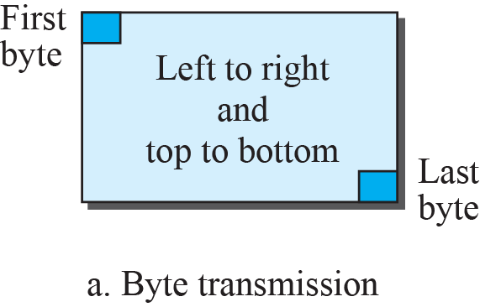
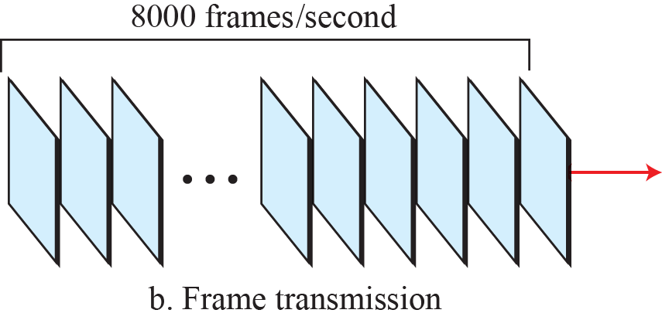
Figure 14.18: STS-1 frames in transition
14.<number>
Notes:
14.#

Slide 16
Example 14.1
Find the data rate of an STS-1 signal.
Solution
STS-1, like other STS signals, sends 8000 frames per second. Each STS-1 frame is made of 9 by (1 × 90) bytes. Each byte is made of 8 bits. The data rate is
14.<number>
13.<number>

Slide 17
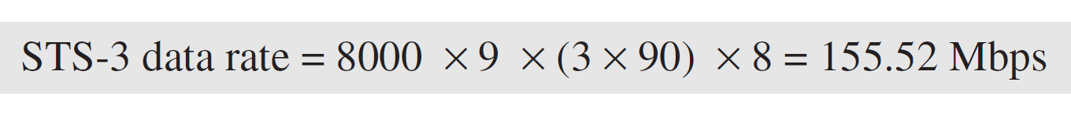
Example 14.2
Find the data rate of an STS-3 signal.
Solution
STS-3, like other STS signals, sends 8000 frames per second. Each STS-3 frame is made of 9 by (3 × 90) bytes. Each byte is made of 8 bits. The data rate is
14.<number>
13.<number>

Slide 18
Example 14.3
What is the duration of an STS-1 frame? STS-3 frame? STS-n frame?
Solution
In SONET, 8000 frames are sent per second. This means that the duration of an STS-1, STS-3, or STS-n frame is the same and equal to 1/8000 s, or 125 μs.
14.<number>
13.<number>

Slide 19
SONET Frames
The data rate of an STS – n signal is n times the data rate of an STS-1 signal
The duration of any frame is 125µs
13.<number>

Slide 20
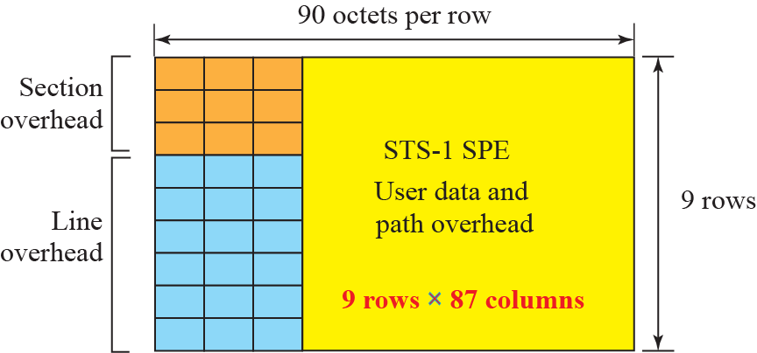
Figure 14.19: STS-1 frame format
SOH, LOH and SPE
14.<number>
Notes:
14.#

Slide 21
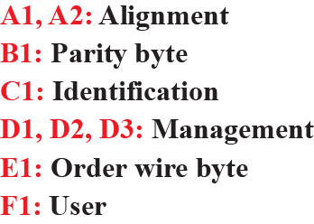
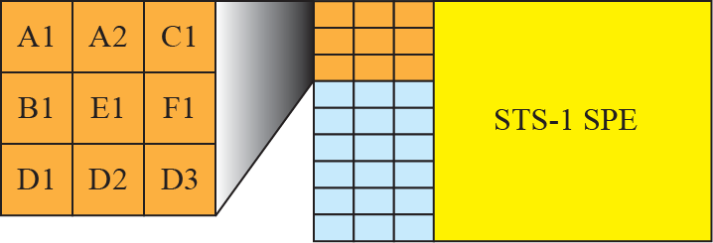
Figure 14.20: STS-1 frame: section overheads
oxF628
- all bytes of previous frame
- Helps for demultiplexing
- OA and M
- Communication between neighbouring devices (64kbps channel)
(Future use)
14.<number>
Notes:
14.#

Slide 22
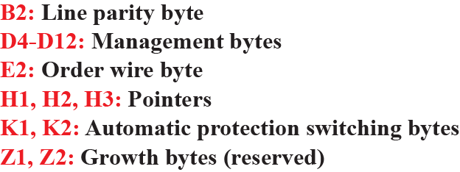
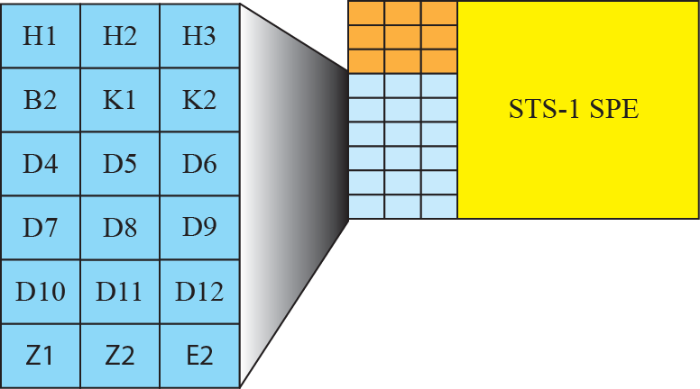
Figure 14.21: STS-1 frame: line overhead
- all bytes of previous frame
- OA and M
- Communication between multiplexers(line level)
- To detect problems with line terminating equipment
14.<number>
Notes:
14.#

Slide 23
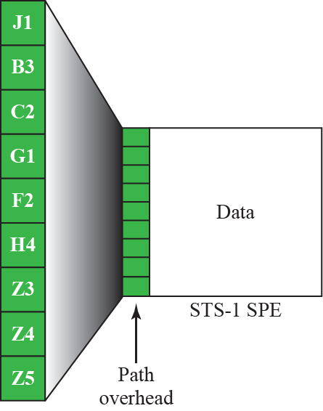
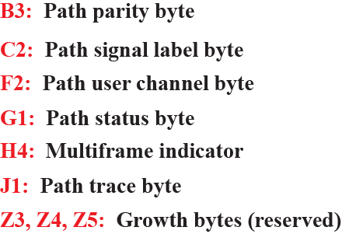
Figure 14.22: STS-1 frame path overhead
- Previous SPE
- To identify higher level protocol
- User needs
- Status to sender in reverse channel
- 64 byte string to verify the connection
14.<number>
Notes:
14.#

Slide 24
Section overhead is calculated for each SONET device (Regenerators and Multiplexers)
Line overhead (each multiplexer)
Path overhead is calculated for end-to-end devices
13.<number>

Slide 25
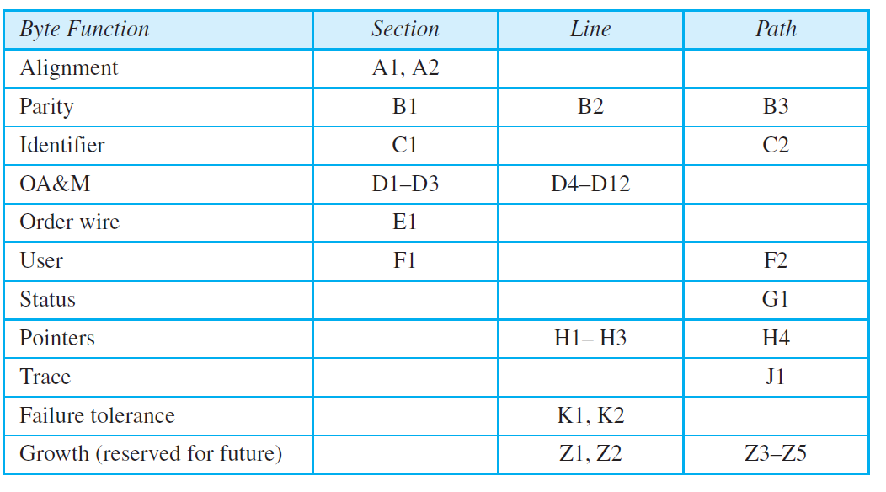
Table 14.2: SONETs overhead
E2
14.<number>
13.<number>

Slide 26
Example 14.4
What is the user data rate of an STS-1 frame (without considering the overheads)?
Solution
The user data part of an STS-1 frame is made of 9 rows and 86 columns. So we have
14.<number>
13.<number>

Slide 27
Encapsulation
SPE need to be encapsulated in an STS-1 frame.
SONET allows one SPE to span two frames
H1 and H2 pointers define the beginning of the SPE
These pointers are located in the line overhead because encapsulation occurs at a multiplexer
13.<number>

Slide 28
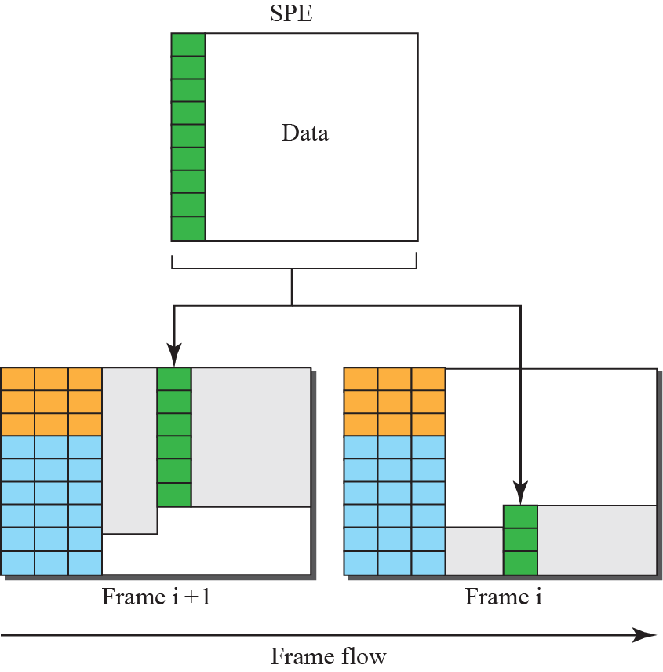
Figure 14.23: Offsetting of SPE related to frame boundary
14.<number>
Notes:
14.#

Slide 29
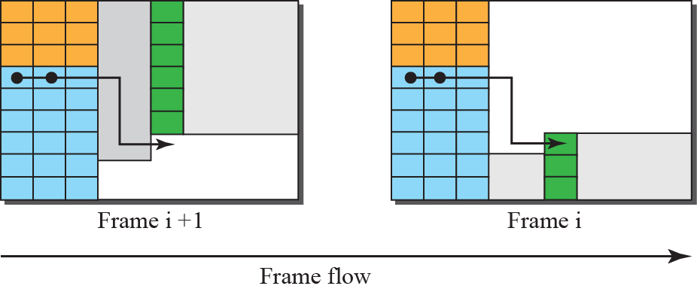
Figure 14.24: The use of H1 and H2 to show the start of SPE
14.<number>
Notes:
14.#

Slide 30
Example 14.5
What are the values of H1 and H2 if an SPE starts at byte number 650?
Solution
The number 650 can be expressed in four hexadecimal digits as 0x028A. This means the value of H1 is 0x02 and the value of H2 is 0x8A.
H3 byte is used for justification
If rate of payload is higher –extra byte inserted in H3 byte
If rate of payload is lower – empty byte after H3 byte
14.<number>
13.<number>

Slide 31
14.3.4 STS Multiplexing
In SONET, frames of lower rate can be synchronously time-division multiplexed into a higher-rate frame.
For example, three STS-1 signals (channels) can be combined into one STS-3 signal (channel), four STS-3s can be multiplexed into one STS-12, and so on, as shown in Figure 14.25.
14.<number>
Notes:
14.#

Slide 32
STS Multiplexing
Multiplexing is Synchronous TDM
All clocks in the network are locked to a master clock to achieve synchronization.
4 STS-3 signals can be multiplexed into one STS-12 signal.
However STS-3 signals need to be first demultiplexed into 12 STS-1 signals and then these 12 signals need to be multiplexed into an STS-12 signal
13.<number>

Slide 33
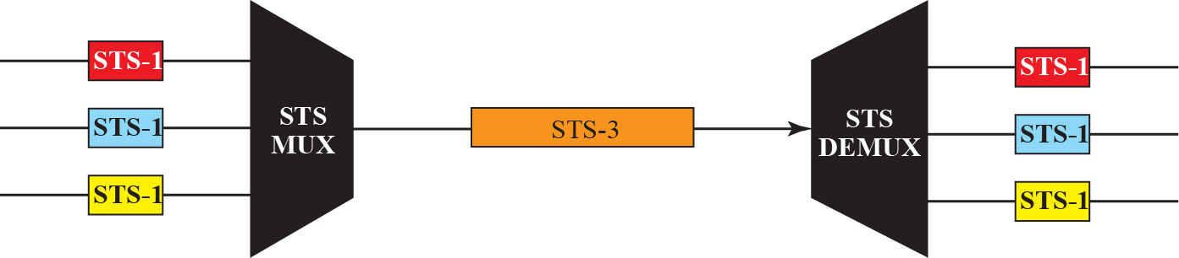
Figure 14.25: STS multiplexing/demultiplexing
14.<number>
Notes:
14.#

Slide 34
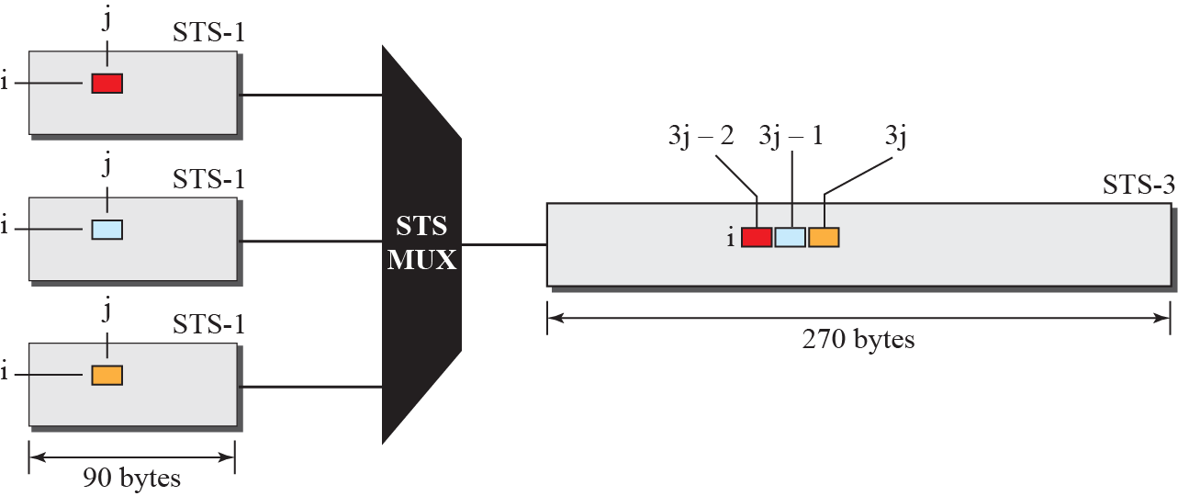
Figure 14.26: Byte interleaving
14.<number>
Notes:
14.#

Slide 35
Byte interleaving
A byte in an STS-1 frame keeps it row position but changes its column position.
Demultiplexing is easier than in statistical TDM.
Demultiplexer deals only with the position of the byte , not its function.
Byte Interleaving preserves the Section and Line overheads.
This may not be true with Path overheads.
13.<number>

Slide 36
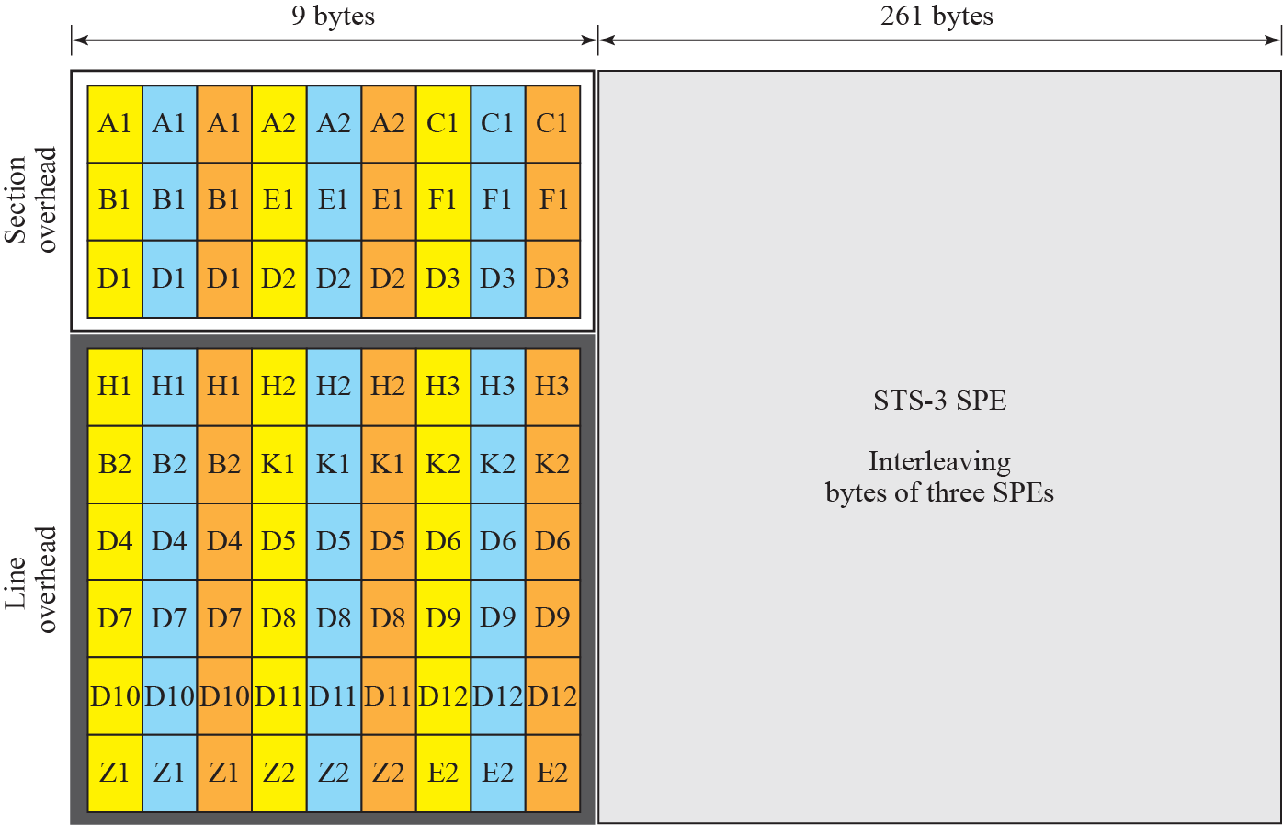
Figure 14.27: An STS-3 frame
14.<number>
Notes:
14.#

Slide 37
Concatenated Signal
In normal operation –an STS-n signal is made of n STS-1 signals
If we have a signal with a data rate higher than an STS-1 signal – SONET consider that as one concatenated STS-n signal.
Eg : STS3c
Here only 9 bytes of path overhead and 260 columns can be used for data.
13.<number>

Slide 38
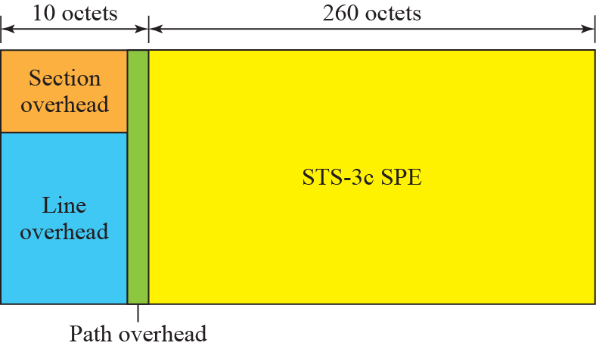
Figure 14.28: A concatenated STS-3c signal
14.<number>
Notes:
14.#

Slide 39
Add / Drop Multiplexer
It replaces a signal with another one.
It operates at the line layer.
Does not create any overheads.
It acts as a switch.
It removes one type of signal and adds same type of signal.
It simply replaces the corresponding bytes with new bytes.
13.<number>

Slide 40
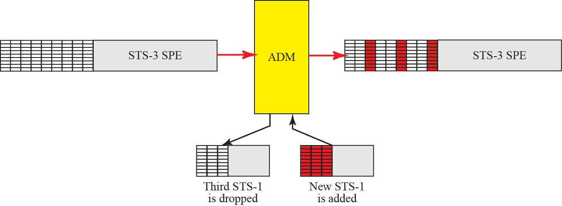
Figure 14.29: Dropping and adding frames in an add/drop multiplexer
14.<number>
Notes:
14.#

Slide 41
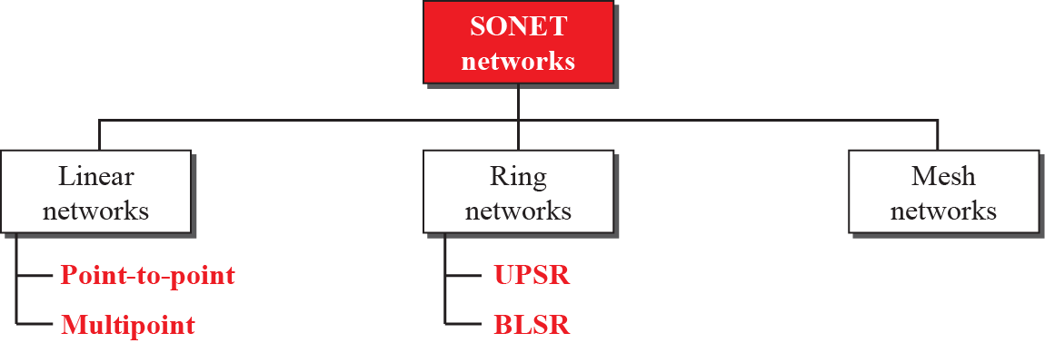
14.3.5 SONET Networks
Using SONET equipment, we can create a SONET network that can be used as a high-speed backbone carrying loads from other networks such as ATM (Section 14.4) or IP (Chapter 19).
We can roughly divide SONET networks into three categories: linear, ring, and mesh networks, as shown in Figure 14.30..
14.<number>
Notes:
14.#

Slide 42
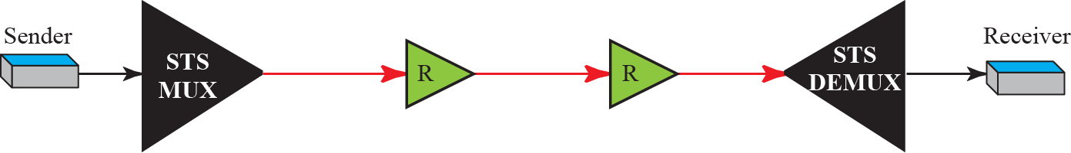
Linear Networks
Point-to-Point Networks
Made up of STS Multiplexer, STS Demultiplexer and zero or more regenerators.
No ADMs.
Signal flow can be unidirectional or bidirectional.
13.<number>

Slide 43
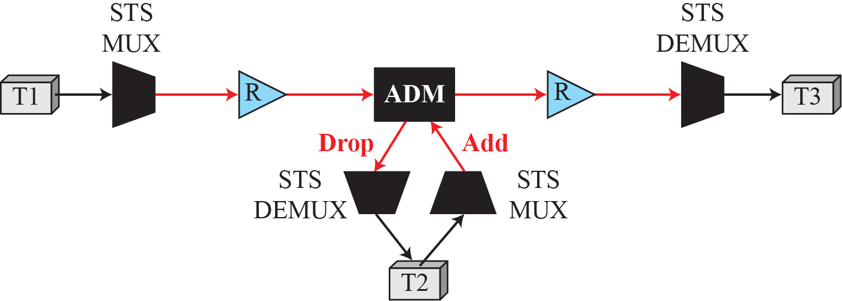
Figure 14.32: A linear SONET network
Multipoint Networks
Uses ADMs to allow communication between Terminals.
Each terminal can send data to one or more downstream terminals.
It can be Bidirectional also.
In the above figure T1 can send data to T2 and T3 simultaneously, whereas T2 can send only to T3.
14.<number>
Notes:
14.#

Slide 44
Automatic Protection Switching (APS)
Linear networks defines APS to create protection against failure.
It is defined at the Path and Line layers.
Idea is to provide redundancy.
Main line is referred to as the Work Line and the redundant line as the Protection Line.
There are Three schemes.
13.<number>

Slide 45
APS in Linear Networks
One-Plus-One APS:
Normally two lines – both are active all the time.
Receiving Multiplexer selects from the line with better quality.
Failure recovery is instantaneous but inefficient.
It is done at the Path layer.
13.<number>

Slide 46
APS in Linear Networks
One-to-One APS:
Normally two lines – data sent on working line until it fails.
At the time of failure receiver uses the reverse channel to inform the sender
Failure recovery is slower than that of one-plus-one scheme
More efficient (protection line can be used for data transfer when not in use)
It is done at the Line layer.
13.<number>

Slide 47
APS in Linear Networks
One-to-many APS:
It is similar to One-to-One except there is only one protection line for many working lines..
Not as secure as One-to-One. If more than one working line fails at the same time, protection can be given only to ne working line
It is done at the Line layer.
13.<number>

Slide 48
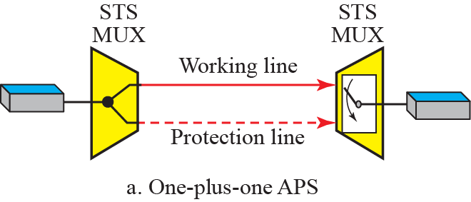
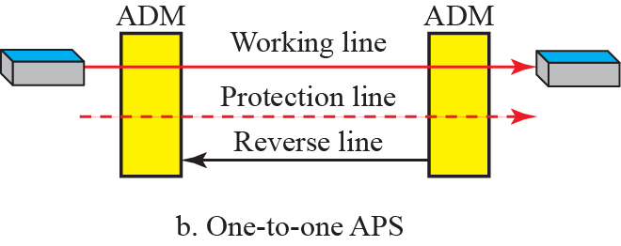
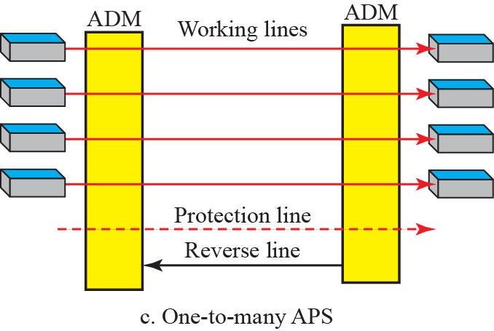
Figure 14.33: Automatic protection switching in linear networks
14.<number>
Notes:
14.#

Slide 49
Ring Networks
ADMs makes it possible to have SONET ring networks
Unidirectional Path Switching Ring:(UPSR)
2 rings, one working ring and one protection ring.
Idea is similar to one-plus-one APS
Same signal flows in both rings in different directions. Receiver selects from the ring with better quality.
Failure recovery is instantaneous but inefficient(Wastage of Bandwidth).
Maintenance is done at the Path layer.
13.<number>

Slide 50
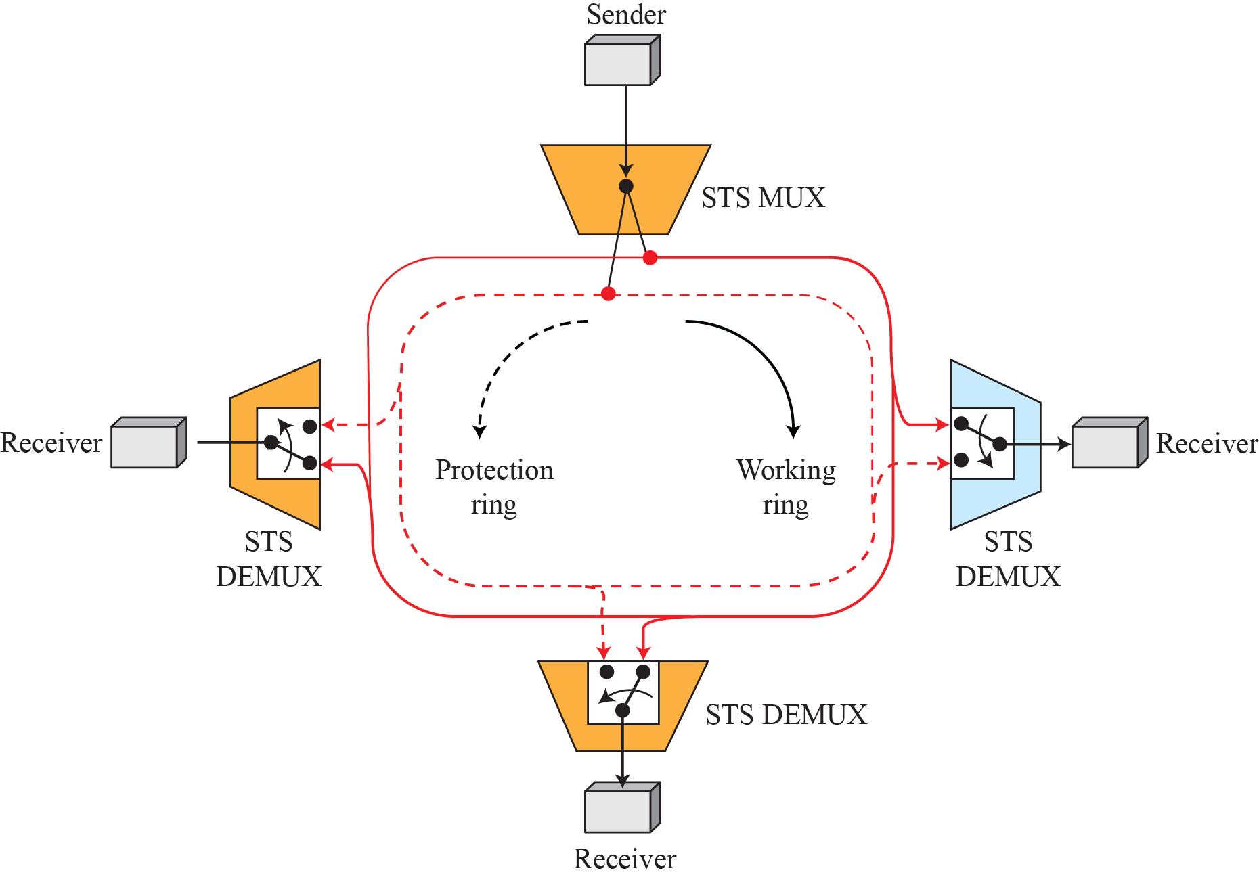
Figure 14.34: A unidirectional path switching ring
Two-way connection
Selection Switch
14.<number>
Notes:
14.#

Slide 51
Ring Networks
Bidirectional Line Switching Ring(BLSR)
2 rings for working line and two for protection line, so 4 rings.
Idea is similar to one-to-one APS
If a working ring fails the receiver uses the reverse channel to inform the upstream node to use protection ring.
. Failure recovery in different situations is possible.
Failure discovery is done at the Line layer by ADMs.
13.<number>

Slide 52
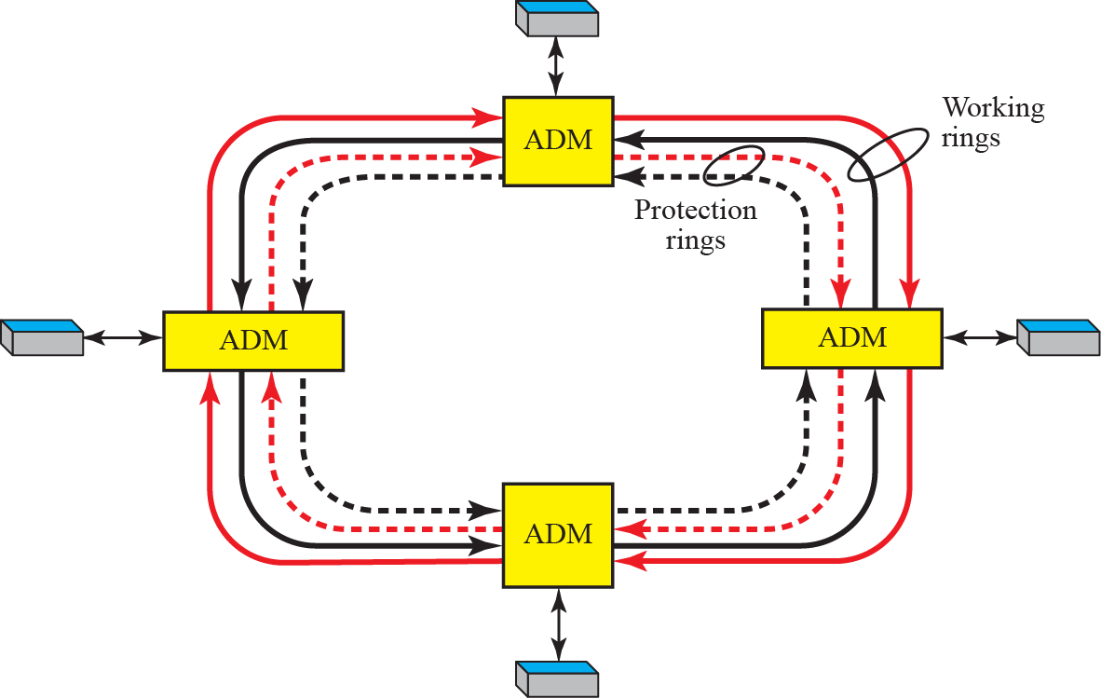
Figure 14.35: A bidirectional switching ring
14.<number>
Notes:
14.#

Slide 53
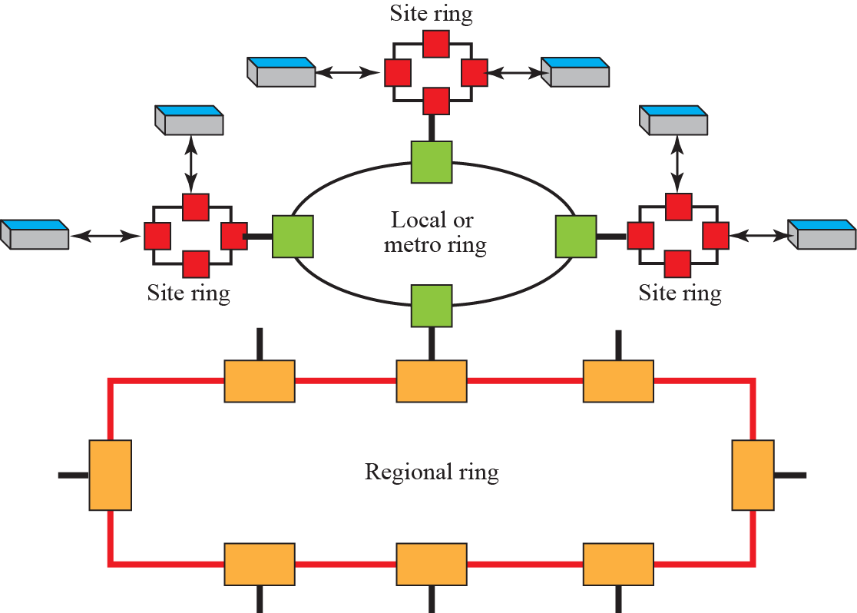
Figure 14. 36: A combination of rings (Wide Area Ring Networks)
14.<number>
Notes:
14.#

Slide 54
Mesh Networks
Problem with Ring networks is lack of Scalability.
To upgrade(when traffic increases) we need to upgrade lines as well as ADMs.
For better performance we go for Mesh Networks.
13.<number>

Slide 55
Mesh Networks
Here a switch is called a cross-connect with input and output ports.
Input port – takes OC-n, changes to STS-n, demultiplexes into STS-1 signals and give to output port.
Output port – takes STS-1 signals, multiplexes to STS-n signals and makes an OC-n for transmission.
Each port acts as both input and output ports, so both Mux and Demux required in each port.
13.<number>

Slide 56
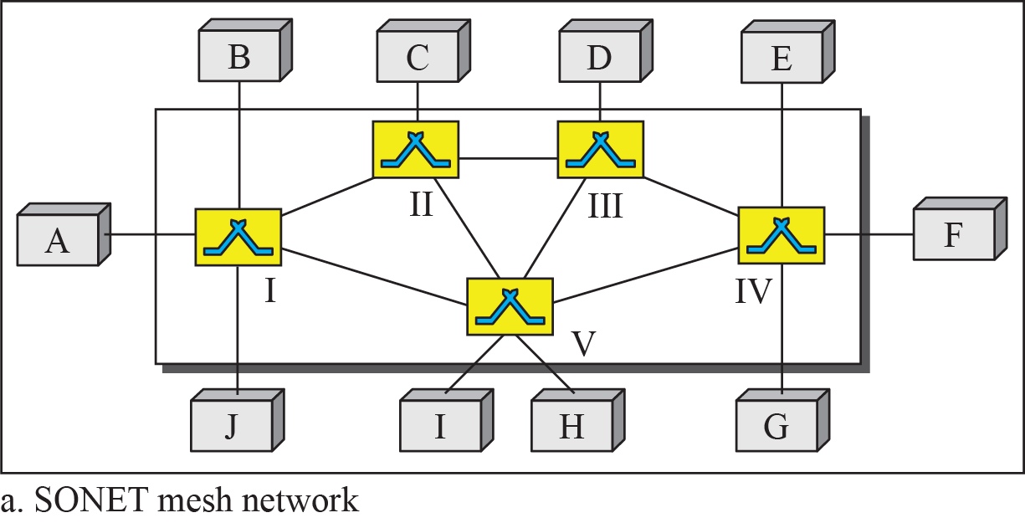
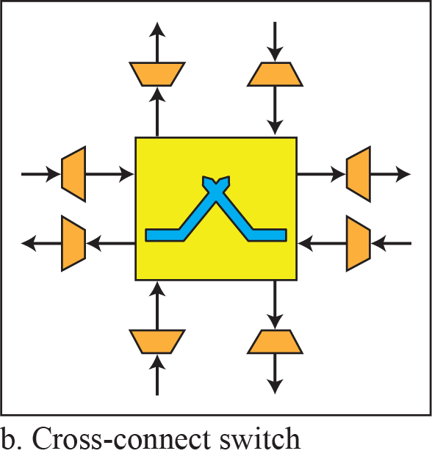
Figure 14.37: A mesh SONET network
14.<number>
Notes:
14.#

Slide 57
14.3.6 Virtual Tributaries
SONET is designed to carry broadband payloads. Current digital hierarchy data rates (DS-1 to DS-3), however, are lower than STS-1 for backward compatibility.
To make SONET backward-compatible with the current hierarchy, its frame design includes a system of virtual tributaries (VTs).
A virtual tributary is a partial payload that can be inserted into an STS-1 and combined with other partial payloads to fill out the frame.
Instead of using all 86 payload columns of an STS-1 frame for data from one source, we can subdivide the SPE and call each component a VT.
14.<number>
Notes:
14.#

Slide 58
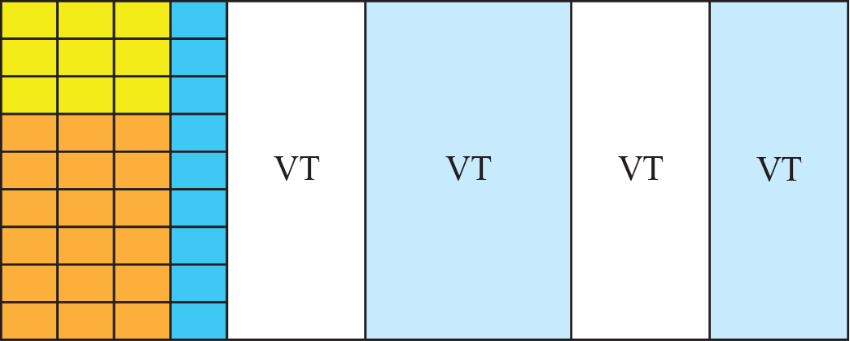
Figure 14.38: Virtual tributaries
Four Types
Number of columns varies
Interleaved column by column
14.<number>
Notes:
14.#

Slide 59
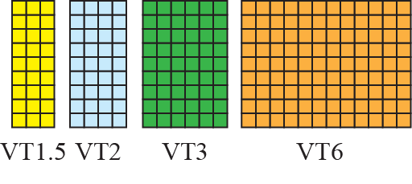
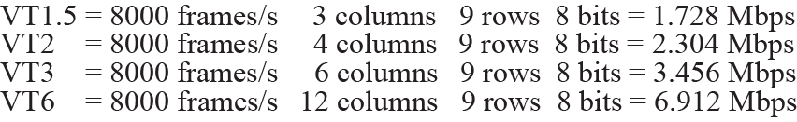
Figure 14.39: Virtual tributary types
14.<number>
Notes:
14.#

Slide 60
Ch. 6: Wireless and Mobile Networks
Background:
# wireless (mobile) phone subscribers now exceeds # wired phone subscribers (5-to-1)!
wireless Networks provide anywhere, anytime untethered Internet access
Wireless devices could be laptops, Internet-enabled phones, palmtops, PDAs etc.
two important (but different) challenges
  Wireless characteristics: communication over wireless link
  mobility: handling the mobile user who changes point of attachment to network
13.<number>

Slide 61



















Elements of a wireless network
network
infrastructure
13.<number>

Slide 62



Elements of a wireless network
wireless hosts
laptop, smartphone, PDA, Desktop
run applications
may be stationary (non-mobile) or mobile
  wireless does not always mean mobility
network
infrastructure
13.<number>

Slide 63
Elements of a wireless network
wireless link
typically used to connect mobile(s) to base station
also used as backbone link
multiple access protocol coordinates link access
various data rates, transmission distance
network
infrastructure
Wireless links are used to connect wireless hosts to the larger network infrastructure (Base Stations) or another wireless host
13.<number>

Slide 64

Elements of a wireless network
base station
typically connected to wired network
Acts as link layer relay
relay - responsible for sending packets between wired network and wireless host(s) in its “area” (range)
  e.g., cell towers, 802.11 access points
network
infrastructure
13.<number>

Slide 65
Elements of a wireless network
infrastructure mode
base station connects mobile hosts into wired network
handoff: mobile changes base station providing connection into wired network
network
infrastructure
If base station is involved then it is operating in infrastructure mode
13.<number>

Slide 66


Elements of a wireless network
ad hoc mode
no base stations
nodes can only transmit to other nodes within link coverage
nodes organize themselves into a network: route among themselves
13.<number>

Slide 67
Wireless network taxonomy
single hop
multiple hops
host connects to
base station (WiFi,
WiMAX, cellular)
which connects to
larger Internet
host may have to
relay through several
wireless nodes to
connect to larger
Internet: some wireless sensor network, mesh net
infrastructure
(e.g., APs)
no
infrastructure
no base station, no
connection to larger
Internet (Bluetooth,
ad hoc nets)
May have to
relay to reach other wireless node
MANET, VANET
13.<number>

Slide 68
Wireless Link Characteristics (1)
important differences from wired link ….
  decreased signal strength: radio signal attenuates as it propagates through matter (path loss)
  interference from other sources: standardized wireless network frequencies (e.g., 2.4 GHz) shared by other devices (e.g., phone); devices (motors, microwave) interfere as well
  multipath propagation: radio signal reflects off objects, ground, arriving at destination at slightly different times
…. make communication across (even a point to point) wireless link much more “difficult”. Bit errors are very common in wireless links.
13.<number>

Slide 69
Wireless Link Characteristics (2)
SNR: signal-to-noise ratio
  larger SNR – easier to extract signal from noise (a “good thing”)(measured in decibels)
SNR versus BER(bit error rate) tradeoffs
  given physical layer: increase power -> increase SNR->decrease BER
  given SNR: choose physical layer that meets BER requirement, giving highest throughput
    SNR may change with mobility: dynamically adapt physical layer (modulation technique, rate)
10⁻¹
10⁻²
10⁻³
BER
10⁻⁴
10⁻⁵
10⁻⁶
10⁻⁷
10
20
30
40
SNR(dB)
QAM256 (8 Mbps)
QAM16 (4 Mbps)
BPSK (1 Mbps)
13.<number>

Slide 70

Wireless network characteristics
Multiple wireless senders and receivers create additional problems (beyond multiple access):
A
B
C
C
A’s signal
strength
C’s signal
strength
B
A
Hidden terminal problem
B, A hear each other
B, C hear each other
A, C can not hear each other means A, C unaware of their interference at B
space
Signal attenuation:
B, A hear each other
B, C hear each other
A, C can not hear each other interfering at B
13.<number>

Slide 71
IEEE 802.11 Wireless LAN
802.11b
2.4-5 GHz unlicensed spectrum
up to 11 Mbps
direct sequence spread spectrum (DSSS) in physical layer
  all hosts use same chipping code
802.11a
  5-6 GHz range
  up to 54 Mbps
802.11g
  2.4-5 GHz range
  up to 54 Mbps
802.11n: multiple antennae
  2.4-5 GHz range
  up to 200 Mbps
all versions use CSMA/CA for multiple access and same frame structure
all have base-station and ad-hoc network versions
They differ in physical layer characteristics
13.<number>

Slide 72
Characteristics of selected wireless links
200
802.11n
54
802.11a,g
802.11a,g point-to-point
5-11
802.11b
4G: LTWE WIMAX
4
3G: UMTS/WCDMA-HSPDA, CDMA2000-1xEVDO
Data rate (Mbps)
1
802.15
.384
2.5G: UMTS/WCDMA, CDMA2000
.056
2G: IS-95, CDMA, GSM
Indoor
10-30m
Outdoor
50-200m
Mid-range
outdoor
200m – 4 Km
Long-range
outdoor
5Km – 20 Km
13.<number>

Slide 73




802.11 LAN architecture
Fundamental building block is BSS (Basic Service Set)
one or more wireless hosts communicates with a central base station
  base station = access point (AP)
Basic Service Set (BSS) (aka “cell”) in infrastructure mode contains:
  wireless hosts
  access point (AP): base station
  Both AP and wireless host has MAC address like Ethernet
Internet
hub, switch
or router
BSS 1
BSS 2
  ad hoc mode: hosts only
13.<number>

Slide 74
802.11: Channels and association
802.11b: 2.4GHz-2.485GHz spectrum divided into 11 channels at different frequencies (partially overlapping channels)
Any two channels are non-overlapping, if and only if they are separated by 4 or more channels. (1, 6 and 11 is the only set of three non-overlapping channel).
- At the time of installation admin gives a SSID(Service Set Identifier) to AP (displayed in available networks)
  AP admin chooses frequency for AP (assign channel No. to AP)
  interference possible: channel can be same as that chosen by neighboring AP!
13.<number>

Slide 75
802.11: Channels and association
WiFi Jungle: any physical location where a wireless host receives a sufficiently strong signal from two or more APs
These APs would likely be located in different IP subnets.
To get internet access each wireless host need to get attached to any one AP.
Association means the wireless station creates a virtual wire between itself and the AP.
13.<number>

Slide 76
802.11: Channels and association
host: must associate with an AP
  AP periodically send beacon Frames
  The wireless station scans 11 channels, listening for beacon frames containing AP’s name (SSID) and MAC address
  selects AP to associate with (by considering the signal strength)
  may perform authentication [Chapter 8]
  will typically run DHCP to get IP address in AP’s subnet
Two types of scanning
13.<number>

Slide 77
802.11: passive/active scanning
BBS 1
BBS 2
BBS 1
BBS 2
1
AP 2
AP 1
1
1
AP 2
AP 1
2
2
2
3
3
4
H1
H1
passive scanning:
beacon frames sent from APs
association Request frame sent: H1 to selected AP
association Response frame sent from selected AP to H1
active scanning:
Probe Request frame broadcast from H1
Probe Response frames sent from APs
Association Request frame sent: H1 to selected AP
Association Response frame sent from selected AP to H1
13.<number>

Slide 78
IEEE 802.11: multiple access
avoid collisions: 2⁺ nodes transmitting at same time
802.11: CSMA - sense before transmitting
  don’t collide with ongoing transmission by other node
802.11: no collision detection! (uses CSMA/CA)
  difficult to receive (sense collisions) when transmitting due to weak received signals (fading)
  can’t sense all collisions in any case: hidden terminal, fading
  Because of limited battery power, making a wireless node receive while transmitting is very difficult
  goal: avoid collisions: CSMA/C(ollision)A(voidance)
Because of high error rate of wireless channels, 802.11 uses link layer acknowledgement/retransmission (ARQ) schemes.
- If the ack does not come within a given amount of time, it assumes that some error occurred and retransmit the frame.
13.<number>

Slide 79
IEEE 802.11 MAC Protocol: CSMA/CA
802.11 sender
1 if sense channel idle, then transmit entire frame (no CD) after a period of time called DIFS(Distributed Inter-Frame space).
2 if sense channel busy then
  start random backoff time
  timer counts down while channel idle
  transmit when timer expires and waits for ack
  if no ACK, increase random backoff interval, repeat step 2
802.11 receiver
- if frame received OK
return ACK after SIFS (Short Inter-Frame Spacing) (ACK needed due to hidden terminal problem and high error rate of the channel)
sender
receiver
DIFS
data
SIFS
ACK
13.<number>

Slide 80
IEEE 802.11 MAC Protocol: CSMA/CA -Avoiding collisions
idea: allow sender to “reserve” channel rather than random access of data frames: avoid collisions of long data frames
sender first transmits small request-to-send (RTS) packets to BS using CSMA
  RTSs may still collide with each other (but they’re short)
BS broadcasts clear-to-send CTS in response to RTS
CTS heard by all nodes
  sender transmits data frame
  other stations defer transmissions
avoid data frame collisions completely
using small reservation packets!
13.<number>

Slide 81

Collision Avoidance: RTS-CTS exchange
A
B
AP
RTS(B)
RTS(A)
reservation collision
RTS(A)
CTS(A)
CTS(A)
DATA (A)
defer
time
ACK(A)
ACK(A)

Slide 82

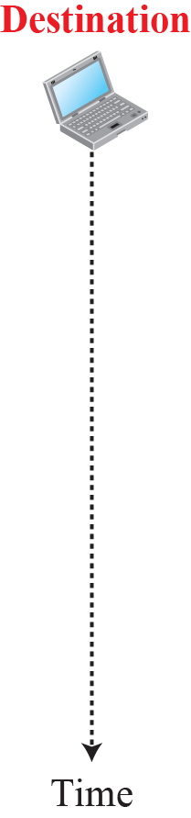









Figure 15.7: CSMA/CA and NAV
NAV: Network Allocation Vector
15.<number>
Notes:
15.#

Slide 83
Collision Avoidance: RTS-CTS exchange
The use of RTS and CTS frames can improve the performance in two ways:
It mitigate the hidden station problem. The data frames are transmitted only after the channel has been reserved.
As RTS and CTS frames are short, collisions involving RTS and CTS will last only for short duration. Once they are clear, Data and Ack frames should be transmitted without collisions.
But RTS and CTS frames introduce some delay in transmission and they consume channel resources.
Solution: use RTS/CTS only for large data frames which cross some threshold.
802.11 can also be used as a point to point link with directional antenna
13.<number>

Slide 84

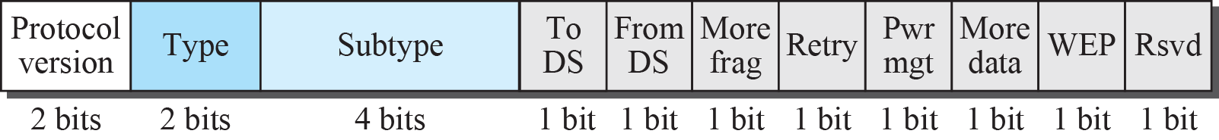
Figure 15.9: Frame format
D -duration of reserved
transmission time (RTS/CTS)
SC -frame seq #
(for Reliable Data Transfer)
Body -IP Datagram or ARP Packet
Four address fields – 3 used in infrastructure mode and 4 used in adhoc mode
Addr 2 – src MAC
Addr 1 - Dest. MAC
Addr 3 – The MAC address of the Router interface which connect to AP
15.<number>
Notes:
15.#

Slide 85
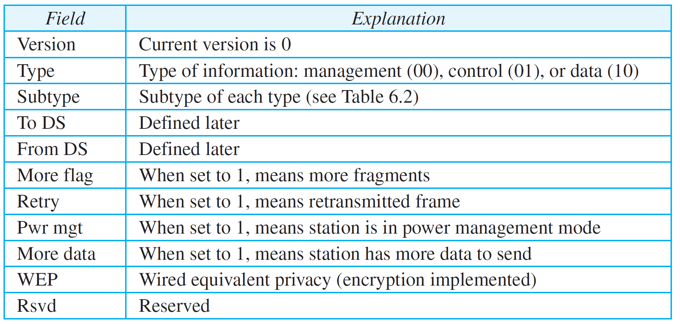
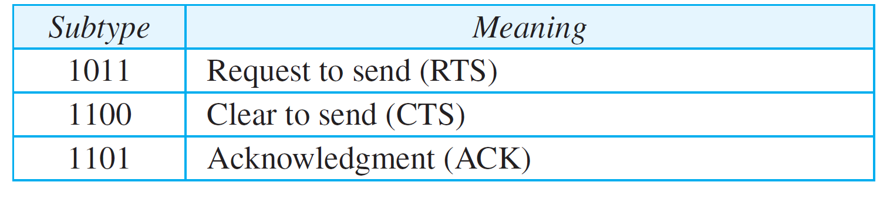
Table 15.1: Subfields in FC field
15.<number>
13.<number>

Slide 86
15.2.3 Addressing Mechanism
The IEEE 802.11 addressing mechanism specifies four cases, defined by the value of the two flags in the FC field, To DS and From DS. Each flag can be either 0 or 1, resulting in four different situations. The interpretation of the four addresses (address 1 to address 4) in the MAC frame depends on the value of these flags, as shown in Table 15.3.
15.<number>
Notes:
15.#

Slide 87
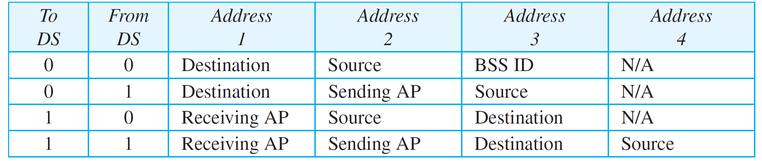
Table 15.3: Addresses
Case 1: The frame is going from one station in a BSS to another without passing through the distribution system.
Case 2: The frame is coming from an AP and going to a station. (addr 3 – original sender)
Case 3: The frame is going to an AP from a station. (addr 3 – final destination)
Case 4: here distribution system is also wireless.
The frame is going from one AP to another AP.
(addr 3 – final destination, Addr4 original sender)
13.<number>
15.<number>

Slide 88
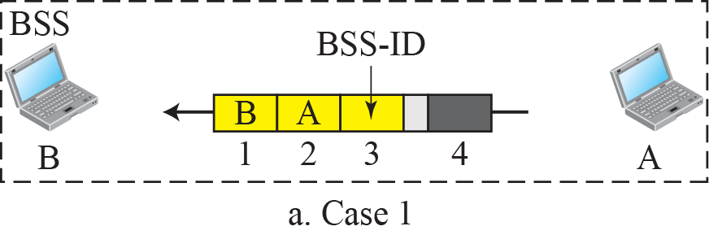
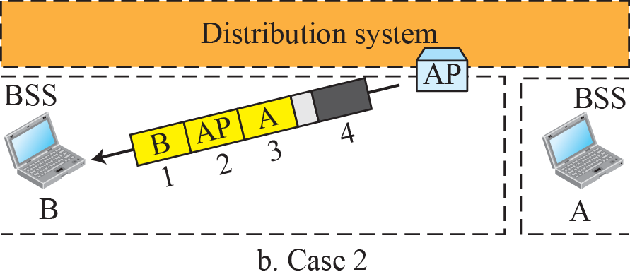
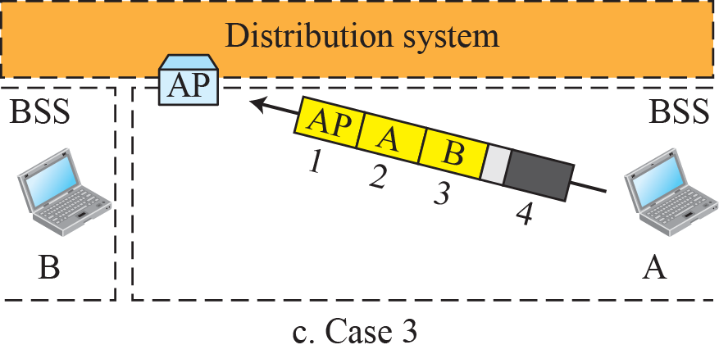

Figure 15.11: Addressing mechanisms
15.<number>
Notes:
15.#

Slide 89

802.11: mobility within same subnet
H1 remains in same IP subnet: IP address can remain same (device used is a switch not router)
switch: which AP is associated with H1?
  self-learning (Ch. 5): switch will see frame from H1 and “remember” which switch port can be used to reach H1
  After new association the new AP broadcast an Ethernet frame to switch mentioning H1’s mac address
BBS 1
H1
BBS 2
6-<number>

Slide 90
    16-2 Cellular Telephony
Cellular telephony is designed to provide communications between two moving units, called mobile stations (MSs), or between one mobile unit and one stationary unit, often called a land unit.
A service provider must be able to locate and track a caller, assign a channel to the call, and transfer the channel from base station to base station as the caller moves out of range.
16.<number>
Notes:
16.#

Slide 91

Figure 16.6: Cellular system
16.<number>
Notes:
16.#

Slide 92
16.2.2 First Generation (1G)
Cellular telephony is now in its fourth generation. The first generation was designed for voice communication using analog signals.
Eg: AMPS – Advanced Mobile Phone System
16.<number>
Notes:
16.#

Slide 93
16.2.3 Second Generation (2G)
To provide higher-quality (less noise-prone) mobile voice communications, the second generation of the cellular phone network was developed.
The second generation was mainly designed for digitized voice. Three major systems evolved in the second generation: D-AMPS, GSM, and IS-95.
16.<number>
Notes:
16.#

Slide 94
16.2.3 2.5 Generation (2.5G)
To allows the mobile users to access the internet through the cellular network, using iPhones, Blackberries, laptops etc.
The 2.5 generation (GPRS) was mainly designed for digitized voice and High speed Internet access.
16.<number>
Notes:
16.#

Slide 95
16.2.4 Third Generation (3G)
The third generation of cellular telephony refers to a combination of technologies that provide both digital data and voice communication.
Using a small portable device, a person is able to talk to anyone else in the world with a voice quality similar to that of the existing fixed telephone network. A person can download and watch a movie, download and listen to music, surf the Internet or play games, have a video conference, and do much more. The third-generation concept started in 1992, when ITU issued a blueprint called the Internet Mobile Communication 2000 (IMT-2000)(UMTS).
16.<number>
Notes:
16.#

Slide 96
16.2.5 Fourth Generation (4G)
The fourth generation of cellular telephony is expected to be a complete evolution in wireless communications.
16.<number>
Notes:
16.#

Slide 97


Components of cellular network architecture
cell
Coverage of cell
covers geographical region
Base Tranceiver Station (BTS) analogous to 802.11 AP
mobile users attach to network through BTS
air-interface: physical and link layer protocol between mobile and BS
power of BTS and mobile devices
obstructing buildings
height of base station antennas
Mobile
Switching
Center
Public telephone
network
Mobile
Switching
Center
wired network
6-<number>

Slide 98

Components of cellular network architecture
MSC
BSS
connects cells to wired tel. net.
manages call setup
handles mobility
Helps in user authorization and accounting
includes cells and BSC (Base Station Controller)
one BSC serve 10s of BTS
One MSC serve 5-6 BSC
BSC is responsible for allocating channels to BTS , perform paging (finding the cell of mobile user) and perform handoff
6-<number>

Slide 99
Cellular networks: the first hop
Two techniques for sharing mobile-to-BS radio spectrum
combined FDMA/TDMA: divide spectrum in frequency channels, divide each channel into time slots
CDMA: code division multiple access
time slots
frequency
bands
6-<number>

Slide 100
2G (voice) network architecture
Base station system (BSS)
MSC
BTS
BSC
G
Public
telephone
network
Gateway
MSC
Legend
Base transceiver station (BTS)
Base station controller (BSC)
Mobile Switching Center (MSC)
Mobile subscribers
6-<number>

Slide 101
3G (voice+data) network architecture
MSC
G
Public
telephone
network
radio
network
controller
Gateway
MSC
G
Public
Internet
Key insight: new cellular data
network operates in parallel
(except at edge) with existing
cellular voice network
voice network unchanged in core
data network operates in parallel
SGSN
GGSN
Serving GPRS Support Node (SGSN)
Gateway GPRS Support Node (GGSN)
6-<number>

Slide 102
General Mobility Management principles (WiFi as well as Cellular)
Mobile node – is the one which changes the point of attachment into the network over time.
a) within the same access network
b) Moves between access networks (not running any application
c) Moves between access networks while continuing communication
13.<number>

Slide 103
What is mobility?
spectrum of mobility, from the network perspective:
no mobility
high mobility
mobile wireless user,
using same access
point
mobile user, connecting/ disconnecting from network using DHCP.
mobile user, passing through multiple access point while maintaining ongoing connections (like cell phone)
6-<number>

Slide 104



Mobility: vocabulary
home network: permanent “home” of mobile
(e.g., 128.119.40/24)
home agent: entity that will perform mobility functions on behalf of mobile, when mobile is remote
wide area network
permanent address: address in home network, can always be used to reach mobile
e.g., 128.119.40.186
6-<number>

Slide 105
Mobility: more vocabulary
permanent address: remains constant (e.g., 128.119.40.186)
visited network(foreign network) network in which mobile currently resides (e.g., 79.129.13/24)
care-of-address: address in visited network.
(e.g., 79,129.13.2)
wide area network
foreign agent: entity in visited network that performs mobility functions on behalf of mobile.
correspondent: wants to communicate with mobile
6-<number>

Slide 106



How do you contact a mobile friend:
Consider friend frequently changing addresses, how do you find her?
I wonder where Alice moved to?
search all phone books?
call her parents?
expect her to let you know where he/she is?
6-<number>

Slide 107
Mobility: approaches
let routing handle it: routers in foreign network advertise this nodes information to all its neighbours via usual routing table exchange.
  routing tables indicate where each mobile located
  no changes to end-systems
  Drawback – scalability issues (size of routing table)
let end-systems handle it:
  indirect routing: communication from correspondent to mobile goes through home agent, then forwarded to remote
  direct routing: correspondent gets foreign address of mobile, sends directly to mobile
6-<number>

Slide 108
Mobility: approaches
let routing handle it: routers advertise permanent address of mobile-nodes-in-residence via usual routing table exchange.
  routing tables indicate where each mobile located
  no changes to end-systems
let end-systems handle it:
  indirect routing: communication from correspondent to mobile goes through home agent, then forwarded to remote
  direct routing: correspondent gets foreign address of mobile, sends directly to mobile
not
scalable
to millions of
mobiles
6-<number>

Slide 109
Mobility: registration
Care-of address(COA)
Permanent address
visited network
home network
1
2
wide area network
mobile contacts foreign agent on entering visited network
foreign agent contacts home agent home: “this mobile is resident in my network”
end result:
foreign agent knows about mobile
home agent knows location of mobile
6-<number>

Slide 110

Mobility via indirect routing
Original datagram is encapsulated in another datagram (adding another header
foreign agent receives packets, forwards to mobile
home agent intercepts packets, forwards to foreign agent
visited
network
home
network
3
wide area network
2
1
correspondent addresses packets using home address of mobile
4
mobile replies directly to correspondent
6-<number>

Slide 111
Indirect Routing: comments
mobile uses two addresses:
  permanent address: used by correspondent (hence mobile location is transparent to correspondent)
  care-of-address: used by home agent to forward datagrams to mobile
foreign agent functions may be done by mobile itself
triangle routing: correspondent-home-network-mobile
  inefficient when correspondent, mobile are in same network
6-<number>

Slide 112
Indirect routing: moving between networks
suppose mobile user moves to another network
  registers with new foreign agent
  new foreign agent registers with home agent
  home agent update care-of-address for mobile
  packets continue to be forwarded to mobile (but with new care-of-address)
mobility, changing foreign networks transparent: on going connections can be maintained!
6-<number>

Slide 113


Mobility via direct routing
(Uses tunneling concept)
foreign agent receives packets, forwards to mobile
correspondent forwards to foreign agent
visited
network
home
network
3
1
2
4
correspondent requests, receives foreign address of mobile
mobile replies directly to correspondent
6-<number>

Slide 114




Mobility via direct routing: comments
overcome triangle routing problem
non-transparent to correspondent: correspondent must get care-of-address from home agent - what if mobile changes visited network frequently?(correspondent ask for COA only once in the beginning)
3
1
2
4
6-<number>

Slide 115


Accommodating mobility with direct routing
anchor foreign agent: FA in first visited network
data always routed first to anchor FA
when mobile moves: new FA arranges to have data forwarded from old FA (chaining)
foreign net visited
at session start
anchor
foreign
agent
wide area network
2
1
4
5
3
new
foreign
network
correspondent
agent
new foreign
agent
correspondent
6-<number>

Slide 116
Mobile IP
RFC 3344 – The Internet architecture and protocols for supporting mobility, collectively known as Mobile IP.
has many features we’ve seen:
  home agents, foreign agents, foreign-agent registration, care-of-addresses, encapsulation (packet-within-a-packet)
three components of Mobile IP standard:
  agent discovery
  registration with home agent
  indirect routing of datagrams
6-<number>

Slide 117
Mobile IP: agent discovery
Agent discovery could be done either using agent advertisement or using agent solicitation.
13.<number>

Slide 118
Mobile IP: agent discovery
agent advertisement: foreign/home agents advertise its services to mobile node by periodically broadcasting ICMP messages (typefield = 9). Thus mobile node learns about the agent’s address.
With agent solicitation the mobile node itself will broadcast the agent solicitation message to get the COA using ICMP message with type value 10. Now the agent will unicast the agent advertisement directly to the mobile node.
6-<number>

Slide 119
Mobile IP: agent Registration
This involves four steps
After receiving foreign agent advertisement, mobile node sends the mobile IP registration message to foreign agent within UDP with port number 434. It includes COA selected, HA address, permanent address of mobile node and the lifetime requested
Foreign agent receives this, note the addresses and send the mobile IP registration message to home agent within UDP with port number 434.
13.<number>

Slide 120
Mobile IP: agent Registration
3) The home agent receives registration request and check for authenticity and correctness. It binds the permanent IP address with COA and sends the registration reply including the actual registration lifetime.
4) Foreign agent receives this, and forwards it to the mobile node.
13.<number>

Slide 121
Mobile IP: registration example
visited network: 79.129.13/24
home agent
HA: 128.119.40.7
foreign agent
COA: 79.129.13.2
mobile agent
MA: 128.119.40.186
ICMP agent adv.
COA: 79.129.13.2
….
registration req.
registration req.
COA: 79.129.13.2
HA: 128.119.40.7
MA: 128.119.40.186
Lifetime: 9999
identification: 714
encapsulation format
….
COA: 79.129.13.2
HA: 128.119.40.7
MA: 128.119.40.186
Lifetime: 9999
identification:714
….
registration reply
HA: 128.119.40.7
MA: 128.119.40.186
Lifetime: 4999
Identification: 714
encapsulation format
….
registration reply
HA: 128.119.40.7
MA: 128.119.40.186
Lifetime: 4999
Identification: 714
….
time
6-<number>

Slide 122

Mobile IP: indirect routing
foreign-agent-to-mobile packet
packet sent by home agent to foreign agent: a packet within a packet
dest: 128.119.40.186
dest: 79.129.13.2
dest: 128.119.40.186
Permanent address: 128.119.40.186
Care-of address: 79.129.13.2
dest: 128.119.40.186
packet sent by correspondent
6-<number>

Slide 123

Components of cellular network architecture
recall:
correspondent
wired public telephone
network
MSC
MSC
MSC
MSC
MSC
different cellular networks,
operated by different providers
6-<number>

Slide 124
Managing mobility in cellular networks
home network: network of cellular provider you subscribe to (In GSM it is called home Public Land Mobile Network {home PLMN})
  home location register (HLR): database in home network containing permanent cell phone #, profile information (services, preferences, billing), information about current location (could be in another network)
visited network: network in which mobile currently resides (visited PLMN)
  visitor location register (VLR): database with entry for each user currently in network
  VLR usually co-located with the Mobile Switching Center (MSC)
  Could be the home network for its subscribers
6-<number>

Slide 125
GSM: indirect routing to mobile
HLR
home
network
2
home MSC consults HLR gets roaming number of mobile (temporary MSRN) in visited network
home
Mobile
Switching
Center
GMSC
correspondent
1
call routed
to home network
3
Public switched
telephone
network
VLR
Mobile
Switching
Center
4
home MSC sets up 2nd leg of call
to MSC in visited network
mobile
user
MSC in visited network completes
call through base station to mobile
visited
network
6-<number>

Slide 126
GSM: indirect routing to mobile
Dials the phone #, leading digits in the mobile number identifies its home network and the call gets routed
HLR
home
network
2
home MSC consults HLR gets roaming number of mobile (temporary MSRN) in visited network
home
Mobile
Switching
Center
GMSC
correspondent
1
call routed
to home network
After entering the visited network the mobile node register with it (VLR), which in turn send location update to HLR of mobile
3
Public switched
telephone
network
VLR
Mobile
Switching
Center
4
home MSC sets up 2nd leg of call
to MSC in visited network
mobile
user
MSC in visited network completes
call through base station to mobile
visited
network
6-<number>

Slide 127
GSM: handoff with common MSC
handoff goal: route call via new base station (without interruption)
reasons for handoff:
  stronger signal to/from new BSS (continuing connectivity, less battery drain)
  load balance: free up channel in current BSS
  GSM doesnt mandate why to perform handoff (policy), only how (mechanism)
handoff initiated by old BSS
VLR
Mobile
Switching
Center
old
routing
new
routing
old BSS
new BSS
Mobile periodically measures the strength of beacon from different BSs and report to its Base station.
6-<number>

Slide 128
GSM: handoff with common MSC
1. old BS informs the visited MSC of impending handoff, provides list of 1 or more new BSs
2. MSC sets up path (allocates resources) to new BS
3. new BS allocates radio channel for use by mobile
4. new BS signals visited MSC & old BS: that it is ready
5. old BS tells mobile: perform handoff to new BS
6. Mobile & new BS exchange few signal to activate new channel
7. mobile signals via new BS to MSC: handoff complete. MSC reroutes call
8 -old-BS resources released
VLR
Mobile
Switching
Center
4
2
1
8
7
3
old BSS
5
6
new BSS
6-<number>

Slide 129
GSM: handoff between MSCs
anchor MSC: first MSC visited by mobile during call
  call remains routed through anchor MSC
new MSCs add on to end of MSC chain as mobile moves to new MSC
optional path minimization step to shorten multi-MSC chain
home network
correspondent
Home MSC
anchor MSC
PSTN
MSC
MSC
MSC
(a) before handoff
6-<number>

Slide 130
GSM: handoff between MSCs
anchor MSC: first MSC visited during call
  call remains routed through anchor MSC
new MSCs add on to end of MSC chain as mobile moves to new MSC
optional path minimization step to shorten multi-MSC chain
home network
correspondent
Home MSC
anchor MSC
PSTN
MSC
MSC
MSC
(b) after handoff
6-<number>

Slide 131
Mobility: GSM versus Mobile IP
GSM element |  | Comment on GSM element | Mobile IP element
Home system | Network to which mobile user’s permanent phone number belongs |  |  | Home network
Gateway Mobile Switching Center, or “home MSC”. Home Location Register (HLR) | Home MSC: point of contact to obtain routable address of mobile user. HLR: database in home system containing permanent phone number, profile information, current location of mobile user, subscription information |  |  | Home agent
Visited System | Network other than home system where mobile user is currently residing |  |  | Visited network
Visited Mobile services Switching Center. Visitor Location Record (VLR) | Visited MSC: responsible for setting up calls to/from mobile nodes in cells associated with MSC. VLR: temporary database entry in visited system, containing subscription information for each visiting mobile user |  |  | Foreign agent
Mobile Station Roaming Number (MSRN), or “roaming number” | Routable address for telephone call segment between home MSC and visited MSC, visible to neither the mobile nor the correspondent. |  |  | Care-of-address
6-<number>

Slide 132
Wireless, mobility: impact on higher layer protocols
logically, impact should be minimal …
  best effort service model remains unchanged
  TCP and UDP can (and do) run over wireless, mobile
… but performance-wise:
  packet loss/delay due to bit-errors (discarded packets, delays for link-layer retransmissions), and handoff
  TCP interprets loss as congestion, will decrease congestion window un-necessarily
  delay impairments for real-time traffic
  limited bandwidth of wireless links
6-<number>

Slide 133
        Thank You
1.<number>

